Slide 1
zomato Restaurant analysis
Mohit Rahangdale
27-01-2026

Slide 2
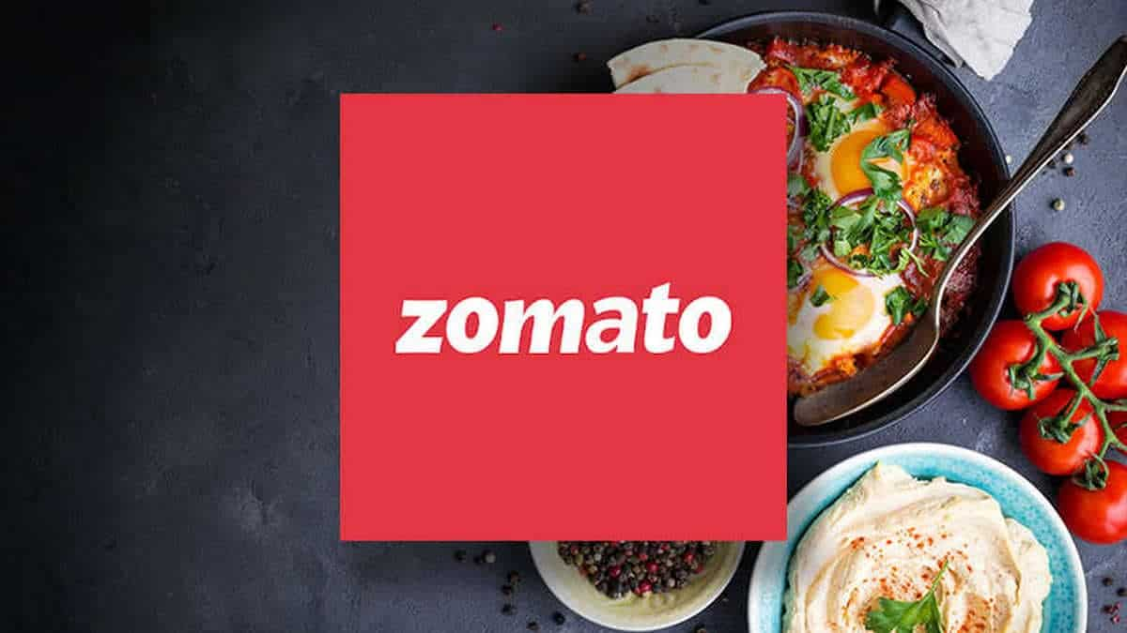
ABOUT ZOMATO
It is India’s biggest online food ordering and delivering platform founded.
It provides different restaurants across the country and various cuisines.
The aim is to pointout which cuisines and locations have higher customer satisfaction.

Slide 3
Problem Statement
You are hired as a consultant data analyst by Zomato where the team is looking for expansion and opening more restaurants. Your task is to develop strategies/suggestions for opening newer restaurants.

Slide 4
Data overview
Total Countries: 15
Average Rating: 2.89
Total Restaurants: 9551
Total Votes: 1498645
Tables: 2 (Raw Data, Country Description)
Attributes: 21
Restaurant Data: LocalityVerbose, City, Address
Customer Engagement Data: Ratings, Votes
Scope: 9551 restaurants across countries.
Operational Data: Online delivery, Table Booking

Slide 5
methodology
Data Integration: Created a dataset of 9,551 restaurants across 15 countries with restaurant locations and service types.
Currency Normalization: A table has been created to normalize data on 'Average Cost for Two' to a standard INR currency to compare it worldwide.
Pre-processing: Clean the data by extracting the year and month values from the date keys.
Aggregation: Used Pivot Tables in order to calculate general performance like overall average rating, which is approximately 2.89, out of total votes of around 1.5 million.
Visualization: Created a dynamic dashboard with key performance indicators, geographical bar charts, and pie charts in visualizing delivery tendencies and favorite cuisines.

Slide 6
Growth trajectory
There is a steady growth from 2010 to 2108.
Peak Year: 2018 saw the highest number of new restaurants (1102).
The year 2012 saw the lowest number of new restaurants.

Slide 7
Global footprint
Dominant Market: India is the largest market of Restaurants , with a total of 8652 restaurants.
Emerging Markets: Canada has the least number of restaurants i.e. 4.
International Presence: The United States of America has 434 restaurants.

Slide 8
Culinary trends
North Indian is the most popular cuisines (936 restaurants), followed by Chinese and Fast Food.
The popularity of “North Indian, Chinese” combination suggests a high demand of their fusion.

Slide 9
Financial analysis
Most Expensive: Singapore has the highest average cost per meals for two.
Most Affordable: Turkey is the most budget-friendly options for restaurants.
Global Average: The overall global average cost for two is Rs. 838.99.

Slide 10
Customer satisfaction
India has the least average rating of 2.77.
Whereas, the Philippines has the highest average rating of 4.468.

Slide 11
Table booking
There are total 0f 9551 restaurants present across 15 different countries.
Out of which 1158 i.e. 12% of total restaurants have table booking.
Whereas 8393 out of 9551 i.e. 88% of restaurants does not have table booking.

Slide 12
Online delivery
There are total 0f 9551 restaurants present across 15 different countries.
Out of which 2451 i.e. 26% of total restaurants have online delivery.
Whereas 7100 out of 9551 i.e. 74% of restaurants does not have online delivery.

Slide 13
Strategic Recommendations
Digital Expansion: Expand Online Delivery and Table Booking options to the remaining restaurants.
Target High-value Markets: Focus on the Philippines, turkey and Indonesia for “Premium: branding, as they have higher customer satisfaction.
Enhance Quality in India: India is the biggest market, increasing the average rating should be the first priority.

Slide 14
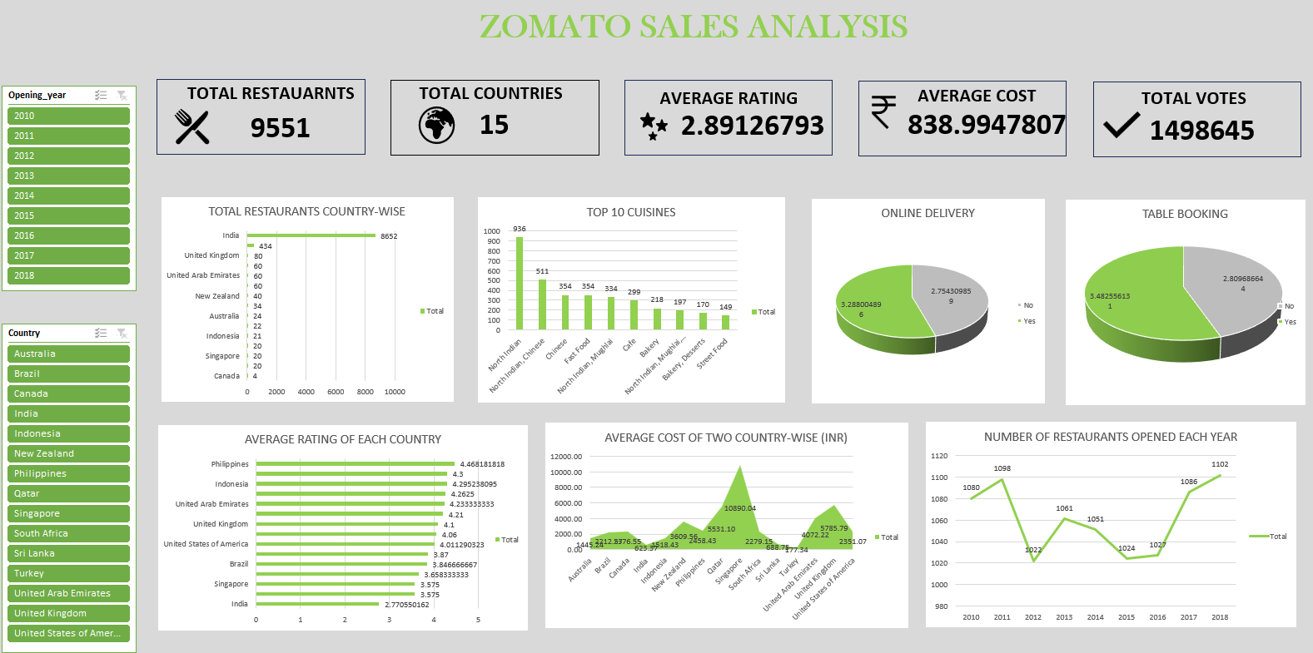
dashboard

Slide 15
conclusions
Before deciding a location for new restaurants, look for the city with high vote counts as there are active customers in that city.
Also, the country or the city with the high average cost is suitable for opening new restaurant, along with the country or the city with high average rating and less number of restaurants.
The countries like Indonesia, Canada and Philippines.

Slide 16
Thank you

